Slide 1
Manufacturing Analysis Report
By group 3

Slide 2
Introduction
In today’s competitive manufacturing landscape, data analysis is pivotal for optimizing operations, improving efficiency, and enabling informed decision-making. Leveraging a comprehensive dataset, this analysis aims to provide actionable insights into manufacturing processes and performance.
Objective
The primary focus of this analysis is to identify inefficiencies, enhance decision-making, improve quality control, and optimize resource allocation. These insights serve as a foundation for driving continuous improvement and ensuring operational excellence within the organization.

Slide 3
Introduction
The dataset we analyzed relates to manufacturing operations and contains a comprehensive record of production activities, encompassing nearly 10,000 entries. This data captures essential details about various products, including item codes, quantities produced, and operational metrics.
Time Frame: The records span is from ‘1 November 2015 to 27 November 2015’, providing insights into production trends over a specific period.
Operational Metrics: Each entry includes critical information such as manufactured quantities, processed quantities, and rejected quantities, which are vital for assessing production efficiency.
Product Classification: Items are categorized by unique item codes and descriptions, allowing for detailed analysis of specific products and their performance.
Employee and Machine Tracking: The dataset also identifies the employees and machines involved in the production processes, facilitating an understanding of resource utilization.

Slide 4
Key Features
Delivery Period is classified as – Early, Late , on Time And Under Production.
Department names are of two types – Printed labels and Woolen labels.
There are 10 operations performed on products as per requirement of each products, operations are Cut & Fold , Cross Checking , Packing , Printing , Supersonic , Weaving, Outsourcing, Laser Cutting , Embroidery and Laser Cutting 2.
Total 78 buyers had manufactured different products and from those H&M and TCP has highest total values.

Slide 5
CHALLENGES FACED
Data Cleaning & Standardization:
Standardizing date formats and numerical values proved challenging, but we resolved these issues by ensuring consistent data formatting across the dataset.
Complexity of Categories:
Operational metrics presented a wide range of categories and values, making visualization difficult. We adjusted visualization techniques for better clarity and understanding.
Performance Optimization:
Large data volumes led to performance issues in SQL queries. By removing unnecessary columns and optimizing queries, we improved load times and query execution speed.
Dynamic Visualization:
Incorporating filters and slicers into visualizations enabled interactive exploration of specific data segments, enhancing user experience without overwhelming them.

Slide 6
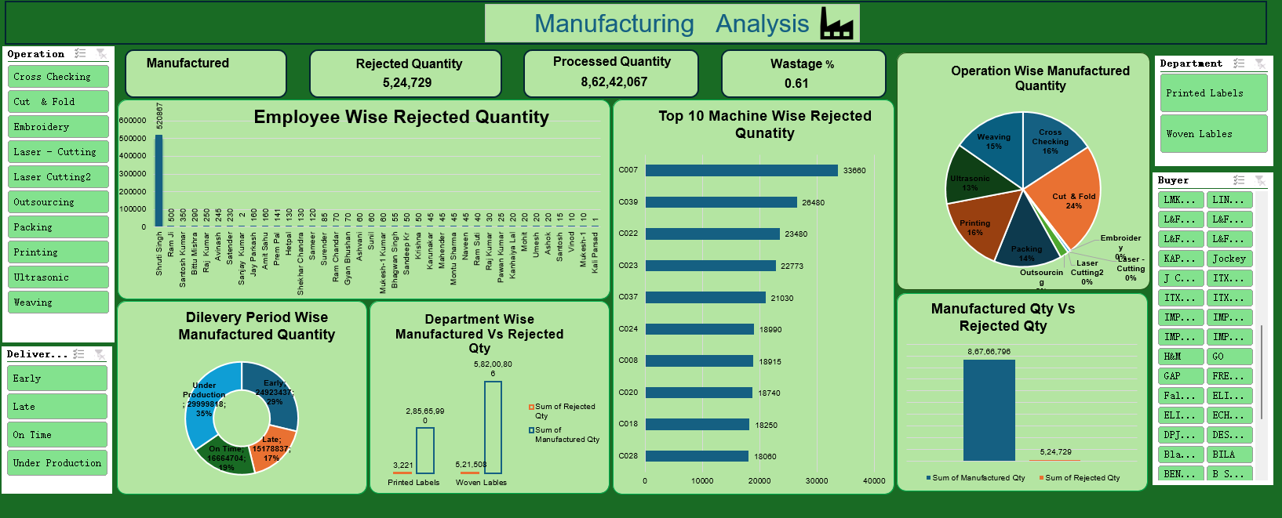
EXCEL DASHBOARD

Slide 7
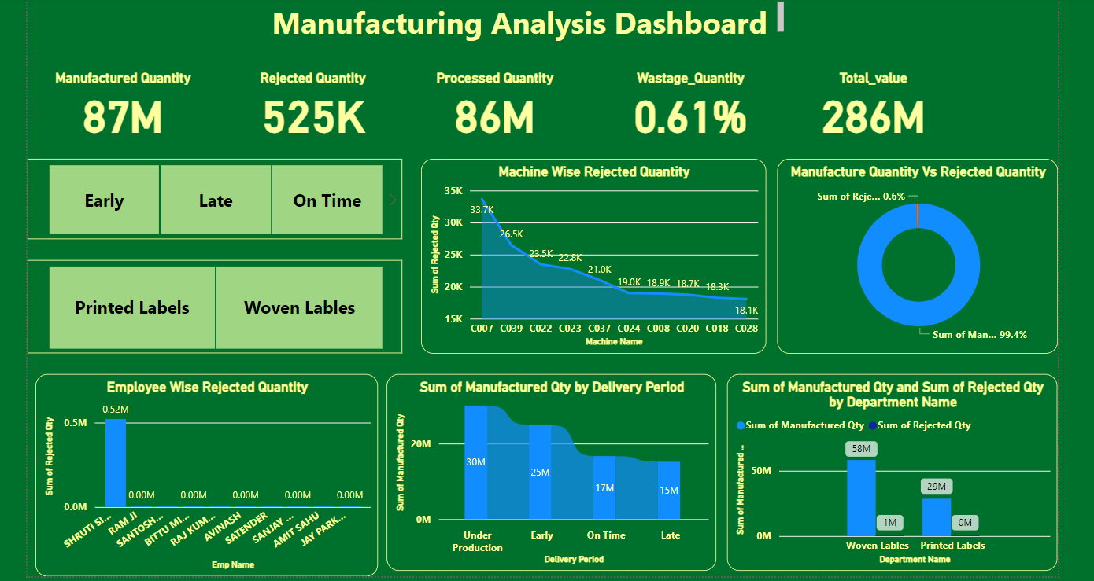
POWER BI DASHBOARD

Slide 8
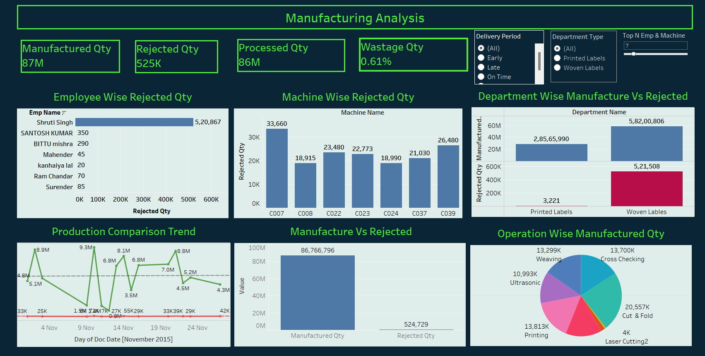
TABLEAU DASHBOARD

Slide 9
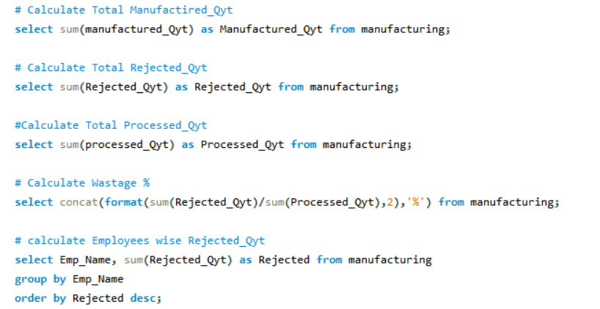
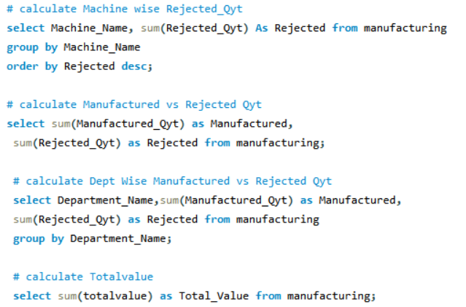
SQL QUERIES

Slide 10
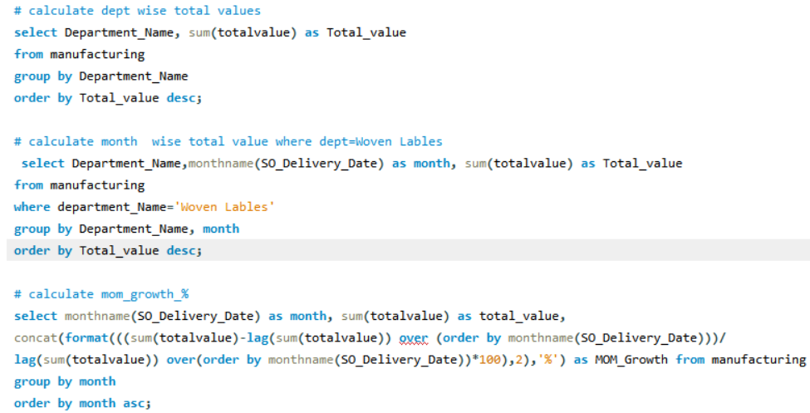
SQL QUERIES

Slide 11
SUMMARY
Production & Rejection:
Manufactured Quantity: 87 million units
Processed Quantity: 86 million units
Rejected Quantity: 525,000 units (0.61% rejection rate)
Wastage & Value:
Wastage Rate: 0.61%
Total Value of Manufactured Items: 286 million
Machine & Employee Performance:
Highest Rejection: Machine C007 (33.7K), C039 (26.5K)
Highest Employee Rejection: Shruti Singh (0.52 million units)
Manufactured vs. Rejected:
99.4% success rate, 0.6% rejection
Process Insights:
Top Manufactured Item: Woven Fabric Size Label (LQW 00062)
Top Rejected Item: Printed Fabric Wash Care Label (PLCE 96)

Slide 12
SUMMARY
Top 5 Buyers which are having highest total values are H & M, TCP , JOCKEY, BENETTON , TRIM TAG. H & M has highest total value of 6,13,40,125.37
CUT AND FOLD operation process has maximum rejected quantity.( 5,21,507 ) which is 99.39 % of total rejected quantity.
Wastage % while manufacturing woven labels is highest that is 0.91% as compared to printed labels (0.01%).
Employee Shruti Singh has worked on highest number of manufactured product (23.63%) also rejected maximum product.

Slide 13
THANK YOU!

